Slide 1
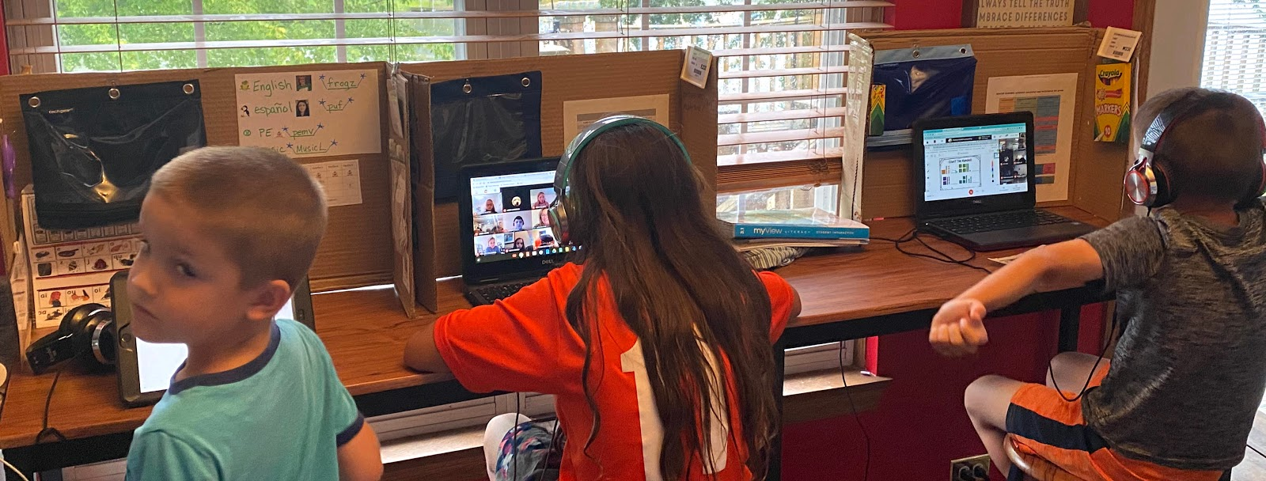
Writing a Classroom Placement Letter
A guide to what to write and share to help your child find the best teacher match
www.creatingbutterflies.com

Slide 2
First Paragraph
Introduce your child by full name
1
State your child’s current grade and teacher
2
This helps the administration locate your child
Provide the grade and school your child will be attending in the fall
3
This ensures the team is thinking about the correct group of teachers, especially if your child is changing schools or programs within the school
Thank the principal for reading your letter
4

Slide 3
Second paragraph
Describe the characteristics to considered when placing your child
See our list on the next two pages
Explain any special circumstances relating to your child
Does your child have a medical condition?
Does your child receive special education services?
Does your child need more support for a specific subject or area of school?

Slide 4
Child characteristics – Type of Learner
Inquisitive
Hands on learner
Active
Imaginative
Adventurous
Inventive
Eager
Curious
Proud
Reserved
Perceptive
Perfectionist
Observant
Detailed
Responsible
Hardworking
Motivated
Industrious
Independent
Advanced in their learning
Thrives on challenges
Fast learner
Flexible
Fearless
Courageous
Fierce
Gutsy
Spirited
Tough

Slide 5
Child characteristics - Interpersonal
Thoughtful
Considerate of others
Nurturing
Patient
Generous
People pleaser
Gentle soul
Introspective
Honest
Sociable
Friendly
Storyteller
Charming
Persuasive
Opinionated
Protective
Assertive
Sarcastic
Candid
Direct
Instinctive
Diplomatic
Constructive
A leader
Free Spirited
Entrepreneur
Spontaneous

Slide 6
Third Paragraph
Learning Environment
Describe the learning environment that best works for your child
See next page for examples of learning environments
Type of Teacher
Explain the type of teacher most beneficial for your child
Some examples are mixed in with the learning environment
Specific Teacher
Name drop a teacher if you have a specific teacher in mind
Friends
Give the name of a friend or two if your child works best with a positive role model
Peers
State specific peers your child works best when not in their class

Slide 7
Learning Environments
Caring and supportive teachers
Challenging academics
Clear expectations and routines
Good home-school communication
Provides extra support for struggling learners
Positive rewards/feedback
Gentle guidance
Reminders or prompts of behaviors
Hands-on or multi-sensory lessons
Strict, rule enforcing teachers
Classrooms that provide choices
Break down multistep projects and problems
Flexible and open to modifying expectations
Students' questions drive learning
Organized with everything in its place
Allows for movement and change
Utilizes small learning groups, encouraging conversations
Provides visual models for students
Appreciates humor and understands sarcasm
Students learn through discussion
Variety of group and independent work
Students have individual supplies and designated areas
Meets students at their level

Slide 8
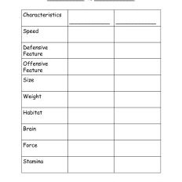
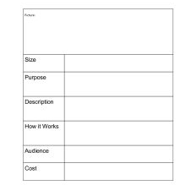
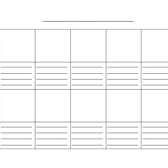
Other Products you may like
Who Would Win Planner
Invention Planning Guide
Comic Worksheet
Easy Writing Templates to Motivate your Child. If your child need a little guidance to begin writing, try these free templates. For a detailed description of each writing guide, check out my blog post on Easy Writing Templates.

Slide 9
Acknowledgements and Thank you
I want to thank you again for purchasing Writing a Classroom Placement Letter. You received my guide detailing what to write with sample language to use in each part of the letter. If you have any questions or concerns, please contact me at creatingbutterfliesfamily@gmail.com. Give me 48 hours to respond, please!
Photos and font credits: Photos are personal photos of my family. Backgrounds and fonts are included with a purchase of PowerPoint software.
Distributing, reselling, altering for non-personal use, or posting pages other than the title page without my permission is prohibited. Please follow my blog for regular updates: www.creatingbutterflies.com.

